Slide 1
Reminders
Homework 1 (not optional) is at weblab.to/homework1 → please complete it ASAP as you will need certain installations for Wednesday’s workshops!
Milestone 0 (not optional) can be found at weblab.to/milestone0 and is due tomorrow, Wednesday 11:59 PM :)
If you still need teammates, please check out the “Search for teammates” post on piazza!
Lunch reminders:
We are serving food to in-person students, but under the agreement that you eat outdoors. No one should be unmasked/eating inside the lecture hall at any point during the day!
When you’re eating outside, please try to spread out, away from other groups. It is important that we be safe about eating, else there’s a chance we may get shut down which will be very BAD.

Slide 2
Reminders
weblab.to/questions
weblab.to/bukabuka

Slide 3
JavaScript
Albert Xing

Slide 4
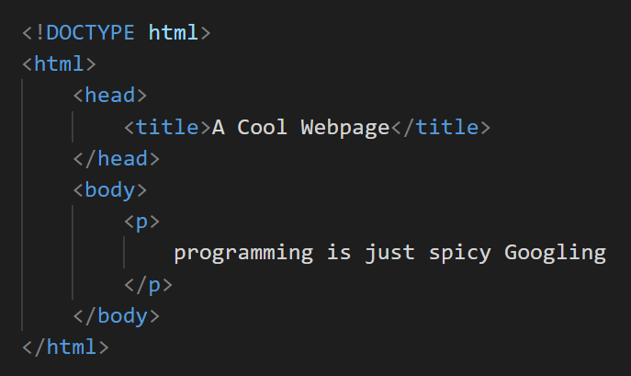
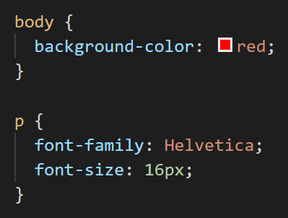
Recap
HTML
Describes content and structure
What exists? How is it organized?
CSS
Describes the presentation
Colors! Fonts! Alignment, margins, borders, shading, and more
Notes:
These together make a static website. No interaction, can’t do more.

Slide 5
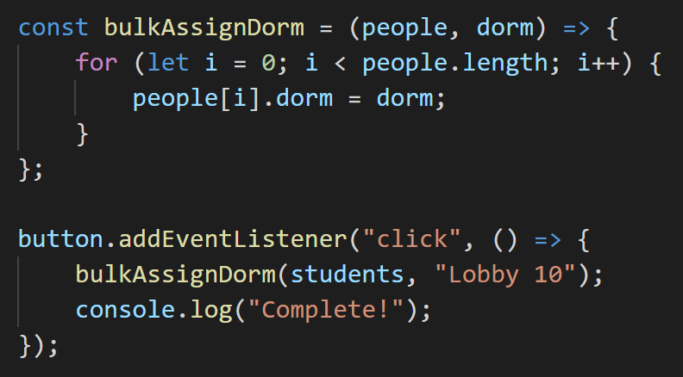
JavaScript is...
... not related to Java 🙃
... a programming language that manipulates the content of a web page
... how we take HTML + CSS and make it interactive!
... used by a vast majority of websites and web applications
Notes:
Can click, use mouse, etc. Lets website respond.
Looks like “standard programming language”

Slide 6

CSS
HTML
JS

Slide 7
Where does it go?
Where can we run JavaScript code?
The browser console
Chrome: Ctrl + Shift + J (on Windows) / Cmd + Option + J (on Mac)
Firefox: Ctrl + Shift + J (on Windows) / Cmd + Shift + J (on Mac)
Tied to our HTML file (more on that later!)

Slide 8
How to JavaScript

Slide 9
Types
JavaScript has 5 primitive data types:
Boolean (true, false)
Number (12, 1.618, -46.7, 0, etc.)
String (“hello”, “world!”, “12”, “”, etc.)
Null
Undefined
Notes:
Number - pos neg, integer, decimal
String - denoted by quotes. Can have empty string
Null and undefined sound familiar, but there is a difference, which i will talk about in a bit.

Slide 10
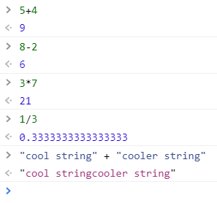
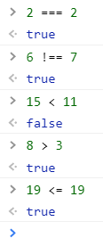
Operators
(note the triple equals sign!)
Things (mostly) work how you would expect:
arithmetic operators
comparison operators
Notes:
Arithmetic operators
Comparison operators
Note triple equal sign
for a ✨fun✨ demonstration of JavaScript being dumb, check out https://www.destroyallsoftware.com/talks/wat

Slide 11
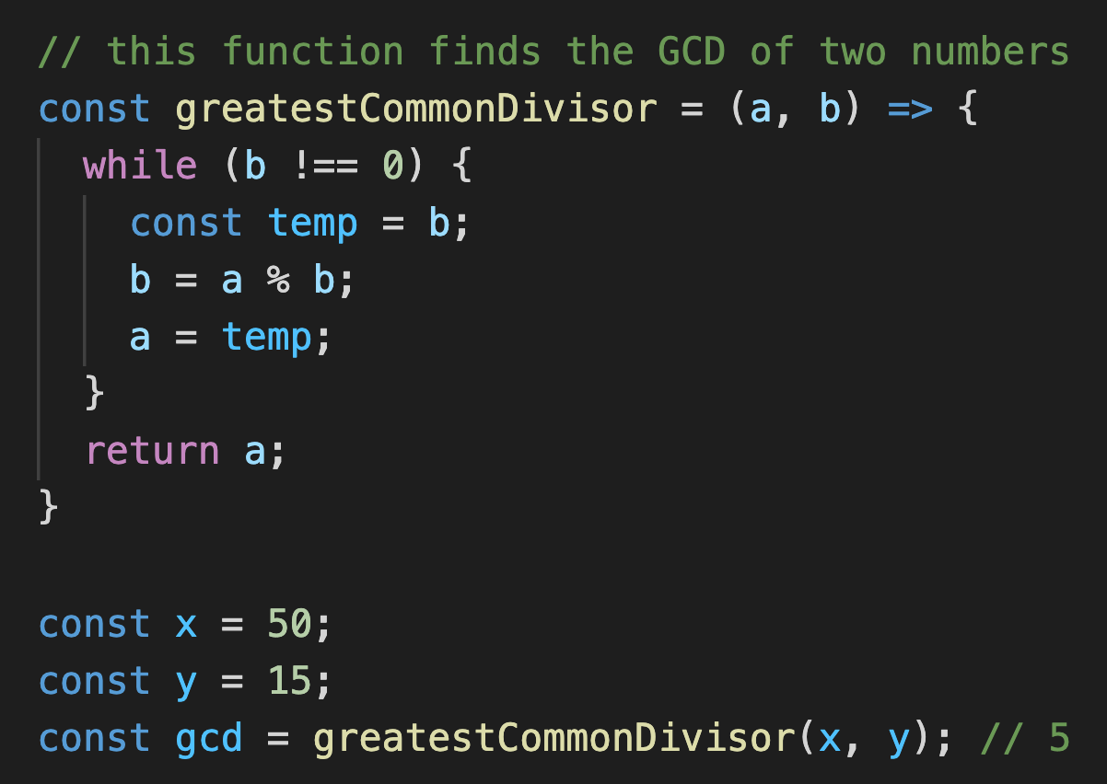
Syntax
Every statement in JavaScript ends with a semicolon;
Whitespace is ignored. (but can improve readability)
Curly braces denote where blocks begin and end.
These are comments.
It doesn’t affect how the code runs, but you should use them to keep your codebase readable!
Notes:
Semicolons - not actually necessary, but using them really improves readability and prevents bugs
Whitespace - can remove or add
Curly braces - blocks
Comments
for a ✨fun✨ demonstration of JavaScript being dumb, check out https://www.destroyallsoftware.com/talks/wat

Slide 12
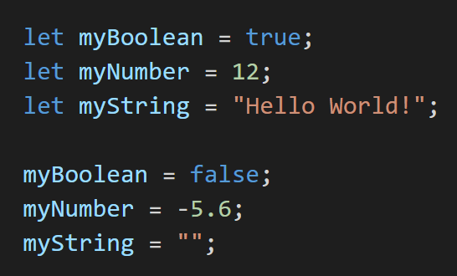
Defining variables
JavaScript convention is to name variables using camelCase.
Notes:
Single equals for variables,
Name that we can “give” a value
In javascript, when you first use a variable, you have to declare it
We use the “let” keyword to declare variable. After this, we can freely change the value
Note: Javascript conventions name variables using camelCase. Every word capitalized except for first.
note: re-declaring a variable with “let” when the variable already exists does not work in strict mode, but it runs without error in non-strict mode

Slide 13
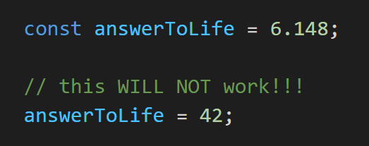
Defining constants
To define a variable which cannot be re-assigned later:
Notes:
Javascript also have constants

Slide 14
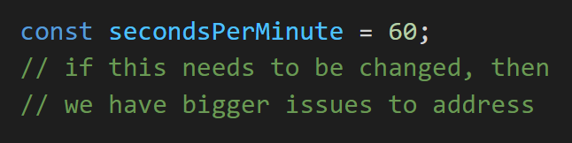
let vs. const
Why bother using const when let exists?
Safe code practices! If something should never be changed, don’t let it change :)
Notes:
Why bother?
Safe code practice. Things that shouldn’t change can’t change. E.g. conversion factor

Slide 15
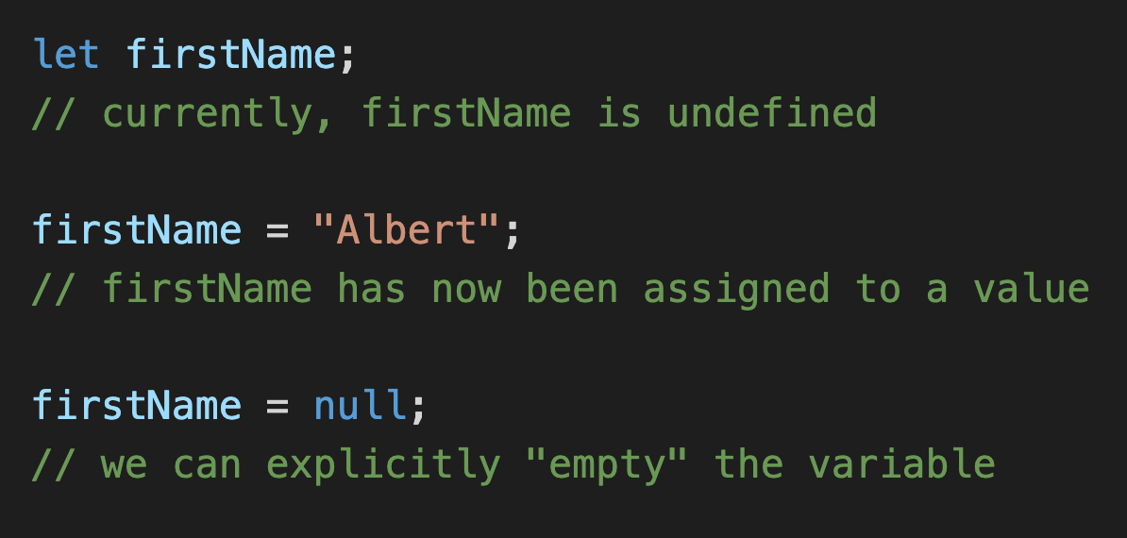
null vs. undefined
undefined means “declared but not yet assigned a value”
null means “no value”
Notes:
Undefined: default value
null: use null to clear a variable. Specifically saying variable is now empty.

Slide 16


let vs. var
tl;dr please don’t use var
technical details (Google it if you’re interested):
let is block-scoped
var is function-scoped
let exists because people kept getting bugs when trying to use var
Notes:
For people who have seen or used js before, may have seen var. Will see code snippets that use it. Short answer is don’t var.
Let was added to js because var would have unexpected behavior. (let has same behavior as other languages)

Slide 17
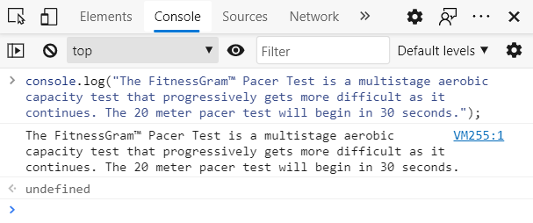
Output
console.log() writes to the JavaScript console:
input
output
Notes:
We often want output.
Prints whatever is given as input to the function.
Equivalent to print functions in other languages.
Why would u use it

Slide 18
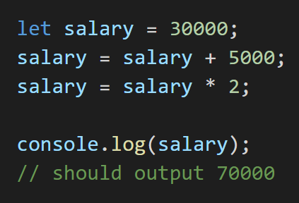
Output
Handy for quick debugging!
Notes:
Used for general debugging purposes

Slide 19

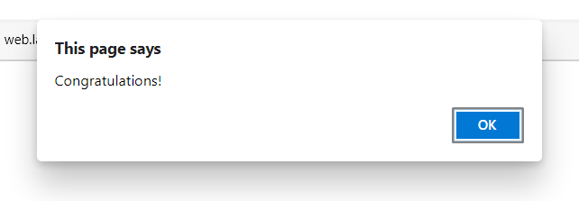
Alerts
alert() generates a pop-up notification with the given content.
Notes:
Another way to provide output is alert. Generates popup notification.

Slide 20
Questions?

Slide 21
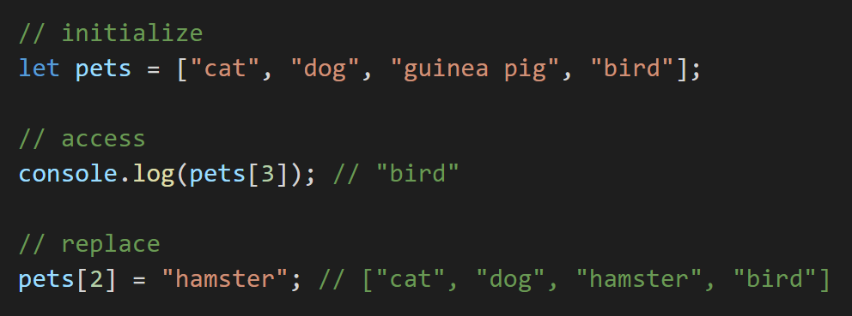

Arrays
For when you want to store a sequence of (ideally similar) items:
Notes:
Up to this point we were talking about primitive data types, here we will start combining them into larger data structures.
Initialize array. Possible to mix types, but generally don’t need to and shouldn’t.
Access element in array, third element
- explain zero-index, and why it will be bird
Replace element in array - can put the element on LHS like a variable

Slide 22
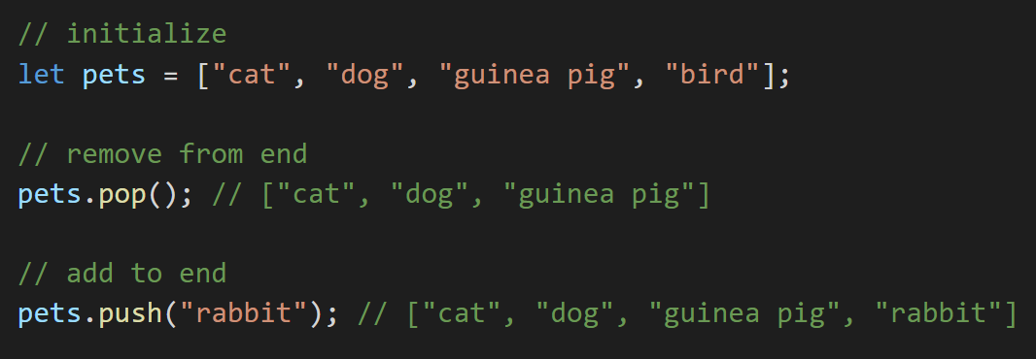
Arrays
Notes:
We will also often want to remove from the end
And add to the end
Lots of other commands to add and remove, like splice

Slide 23
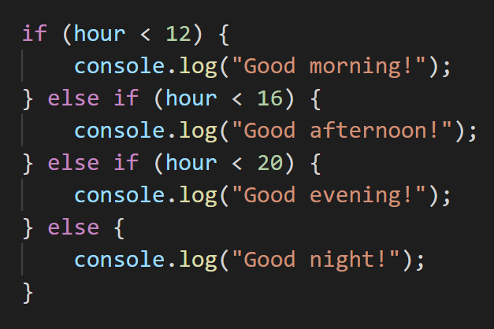
Conditionals
We often want to perform different actions in response to different conditions.
For this, we use the conditional operators if, else, and else if:
Note the indent (tab)!
It’s not necessary, but it will make your code much more readable.
Notes:
Works like in english
If this is true, do this. Otherwise, if …
Python uses elif
Indents not necessary, but we use them to keep code cleaner and organized

Slide 24

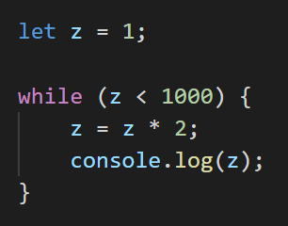
While loops
What if we want to repeat an action as long as some condition is satisfied?
Notes:
While loop runs a certain block of code as long as a condition is satisfied
What does this code print?
It does print out 1024, check after block.
Be wary of syntax: parentheses and curly braces, which might be different from the language you’re coming from.

Slide 25
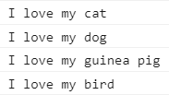
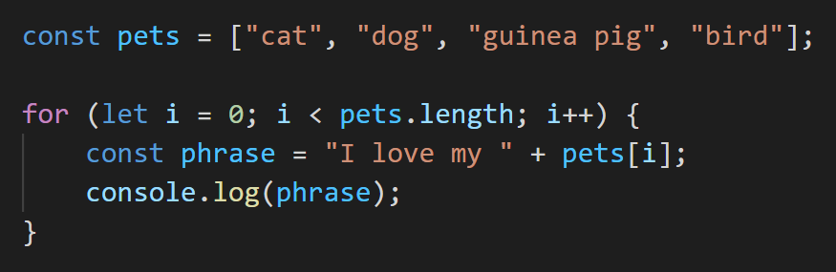
For loops
Useful when we want to iterate through indices:
Notes:
Same array as before
For loop works as follows:
- create an index variable i that starts off as 0
- second chunk is the condition that the loop will check before every step
- third section (i++) shorthand for i = i+1, increments by 1 every step
This loop will output 4 strings, one for each.
Note that const is used inside the block. Can use here, since phrase only exists inside the block. Once leave, it is deleted.
Be wary of syntax: parentheses and curly braces, which might be different from the language you’re coming from.

Slide 26
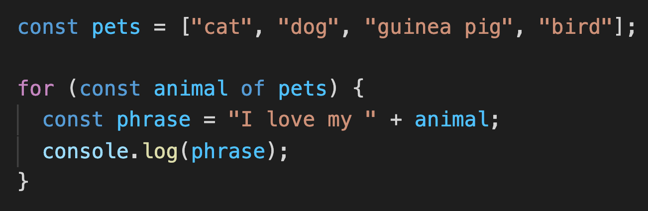
For … of …
A more “pythonic” way of iterating:
Requires the keyword of instead of in
Notes:
Another way of iterating, specifically for arrays and other “iterable” types.
You won’t ever actually need this, since you can just use the regular for loop syntax, but I am just putting this out there in case you see it.
One big difference from python however, is that you must use of instead of in.
I would generally caution against using this syntax, since you don’t actually need it and it is just another thing to remember. And more importantly, if you’re coming from python, you might be accustomed to typing for blank in blank. The issue is that the syntax for … in … also exists in js, but it does something completely different and you might accidentally type “in”.

Slide 27
Questions?

Slide 28
Functions
A function is a compartmentalized block of code which can be given input and asked to perform a set of instructions on that input.
input
function
return value / output (optional)
Sometimes, we want the function to return an output value.
Other times, what matters more is what happens inside the “box” (the function body).

Slide 29
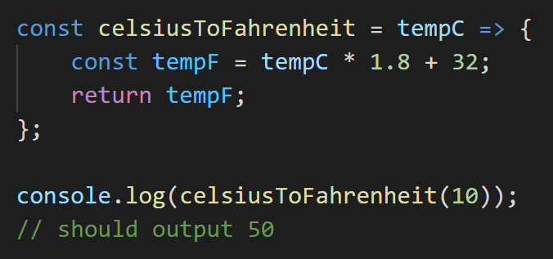
Functions
JavaScript functions can be defined using this cute little arrow =>
Syntax: (parameters) => { body };
parentheses are optional if there’s only one parameter
The actual parameter value(s) given to the function are called arguments.
Notes:
There are other ways to assign a function in js, but we are going to stick with this one for consistency. This is a more modern option.
The syntax above starts at tempC which is then taken to some body.
Inside the body, it creates a new var, which is then returned.
Note that we are assigning the function exactly in the same way we assign to a variable

Slide 30
Callback functions
In JavaScript, functions can be passed around like any other variable.
This means we can give a “callback” function as an argument to another function!
Why might we do this?

Slide 31
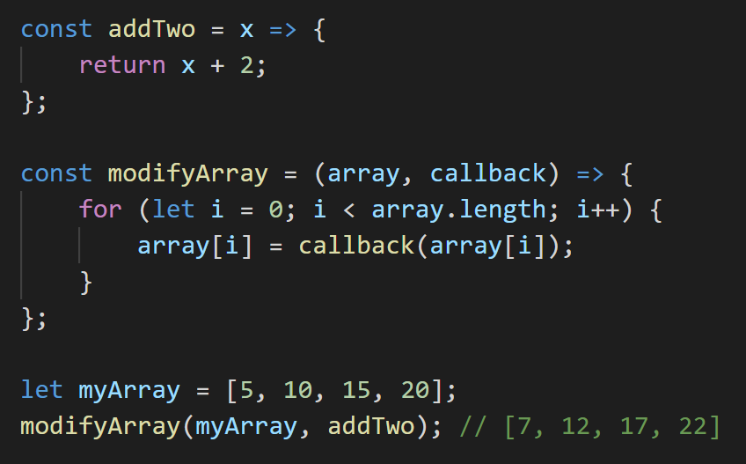
Callback functions
Notes:
Add two
Then we get to the good stuff, modifyArray, which takes in two parameters, an array, and a callback function.
What happens here is that it is going through the array, and applying this function to every element in the array and updating the elements. So it edits the array in place, by calling the callback function on every element.
So what we can do is take in an array, myArray here, and then modify that array using this function.
What is nice is that later we can reuse this code here on a different array, and maybe with a different callback fn. So we can still use modifyArray on something else without changing the function.
We are introducing it now, because it is going to be very important to a lot of functionality later, especially when we get to react later today and tomorrow. So you are going to see the idea of a callback function a lot.

Slide 32
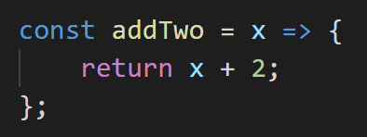
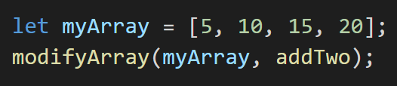

A common mistake with callback functions
addTwo is a function.
addTwo(x) is the value that gets returned when you run addTwo on x.
modifyArray needs to be given the actual function in order to use it!
Don’t do this:
Notes:
Add two vs the value of it when called
We often see.
modifyArray must actually be given the name of the function.

Slide 33
Callback functions
Notes:
This is the same function from the example before, highlighted.
We are assigning it to a variable here.
We are only using it once.
Do we actually have to give it a name and then use its name?

Slide 34
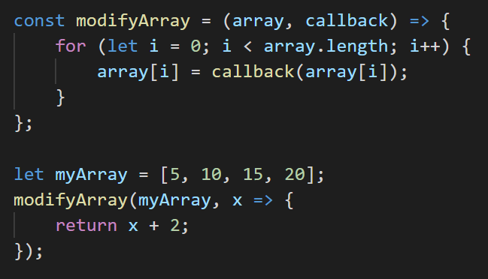
Anonymous functions
Notes:
Instead, what you can do in javascript is turn this into an anonymous function, where you can cut out the naming step and just use the fn directly.
So instead of creating it, naming it, and then using it via the name.
Can just create it on the spot, where you are going to use it when you need.
Highlighted code is the same.

Slide 35
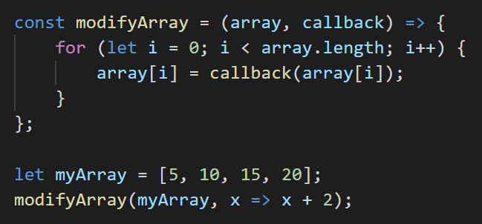
Anonymous functions
If your function is simple enough, you can use the following shorthand.
Syntax: (parameters) => output;
Notes:
If your function is simple, i.e. only one statement in the body, you can even simplify the syntax further, and instead of going through curly braces and having a return statement. Simply have the arrow pointing to the output statement without the curly braces.
Useful when function is super simple.

Slide 36
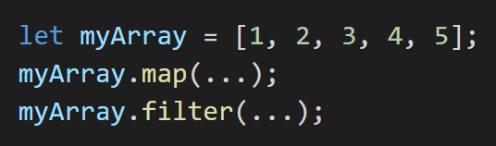
Other built-in array functions
If it seems common enough, there’s probably a built-in function for it!
For arrays, we’ve seen push and pop, which mutate the target array in-place.
We also have map and filter, which produce a new array based on some instruction. (This “instruction” is going to be a callback function!)

Slide 37
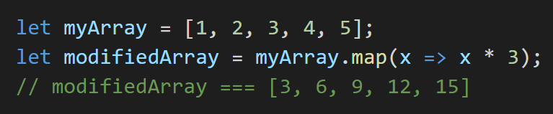
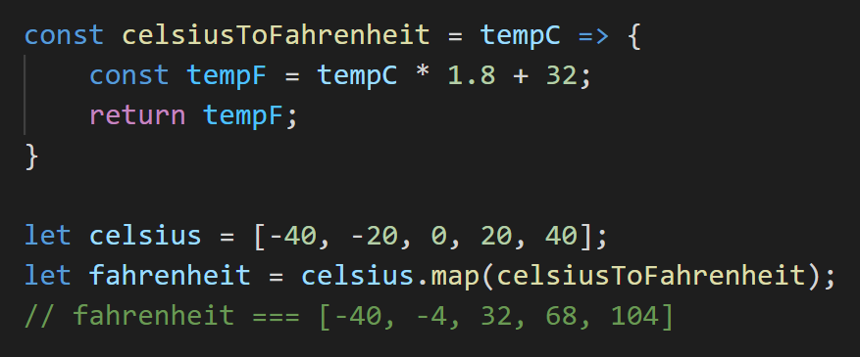
map(...)
Creates a new array by applying the callback function to every element of the starting array.
Notes:
Similar to what we just do, except creates a new array and doesn’t mutate original, but spits out a new one. So it “maps” the elements of an array onto another array.
Can also do something a little more complicated, e.g. convert C to F.

Slide 38
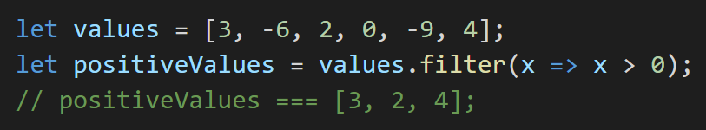
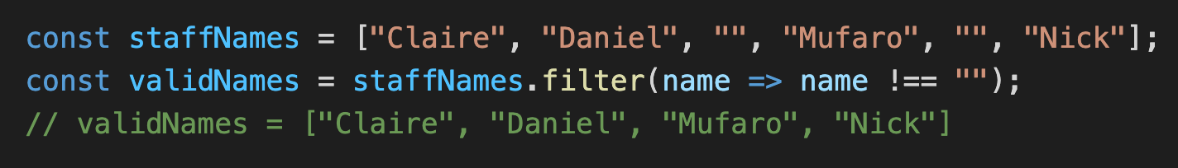
filter(...)
Creates a new array by selecting the elements in the starting array which pass the given “test” (i.e. filtering out the “bad” elements and keeping the “good” ones).
Notes:
Two examples again.

Slide 39
Questions?
Comments?
Concerns?
Notes:
The next topic is

Slide 40
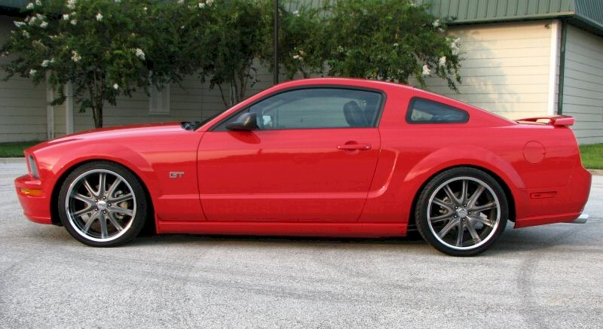
Wait, we don’t have a primitive data type for this
Notes:
If we want to store data, that’s not just one value. For example, if we wanted to store something more complicated like the data about a car, e.g. make, model, color, we have…

Slide 41
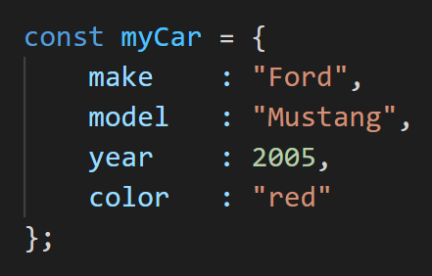
Objects
A JavaScript object is a collection of name:value pairs.
Notes:
We create objects, which are collections of properties. Each property has a name, describing what it is, and a value describing what the value of this objects property is.
Syntax: curly brace around, colons to separate names and values, and commas to separate pairs. Lets you store related data in one variable.
Can think of them as the javascript equivalent to python dictionaries
So what can we do with this

Slide 42
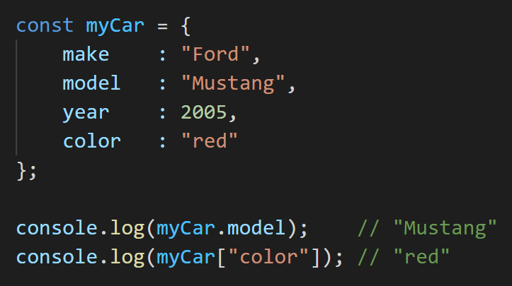
Accessing properties
There are two ways to access object properties, if you know the property name:
Notes:
If you know the property names, you can get the values

Slide 43
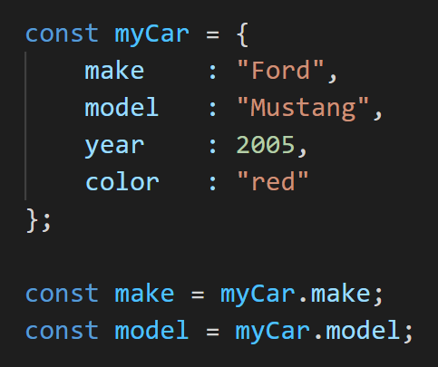
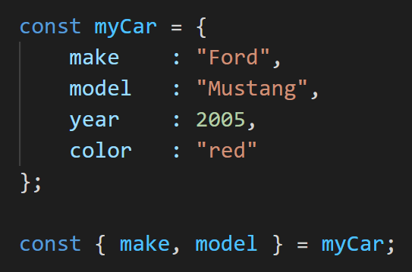
Object destructuring
Object destructuring is a shorthand to obtain multiple properties at once.
without object destructuring
with object destructuring
Notes:
Say you want to get more than one properties out of an object at once. There is a shorthand called obj destructuring. Use it to save space and make cleaner code.

Slide 44
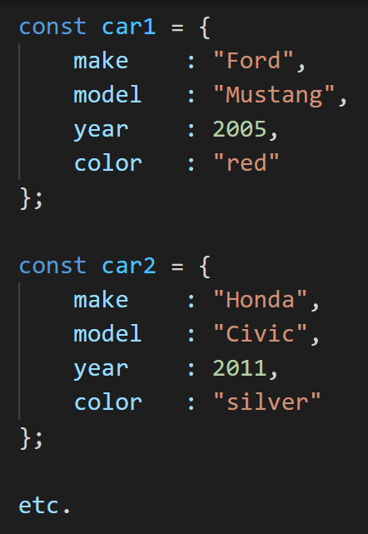
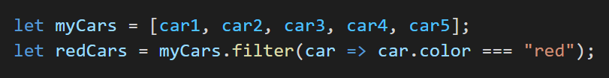
Using objects
We can treat objects like any other variable!
For example, given an array of car objects, we can apply a filter to just keep the red ones:

Slide 45
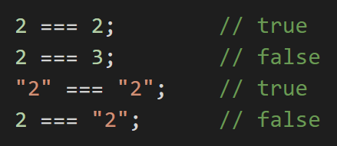
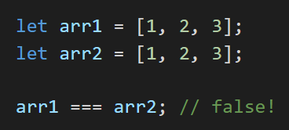
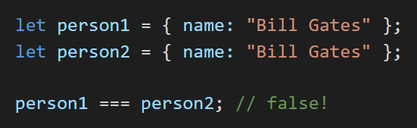
Equality...?
We use === to check if two primitive variables are equal in JavaScript.
But what does === mean for arrays and objects?
Notes:
2 === ‘2’ is false because diff types
Use console for arr1 = [1,2,3]; arr2 = [1,2,3]; arr1 === arr2
See same behavior for arrays and objects

Slide 46
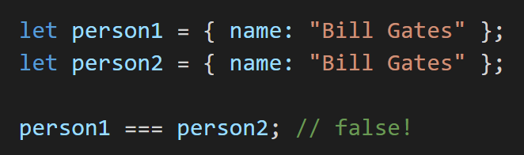
Object references
Object variables are references – they point to where the data is actually stored.
person1
person2
Object
Object
name:
“Bill Gates”
name:
“Bill Gates”
=== checks if the references are equal.
Two objects created separately are stored separately, so their references are different!
Same goes for arrays – two arrays created separately have different references.
Notes:
Object variables are references, it just points to where an object is located in memory. So when creating an array, or an object, just put this in memory and has the variable point to that object in memory. All they know is where they point to.
=== checks if references point to the same spot
Primitives check actual values, more complicated data types things just check references.

Slide 47


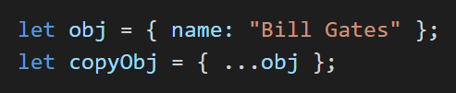
How to copy arrays and objects
It’s not as simple as
(Why not?)
One way to copy arrays and objects is to use the spread operator (...) like so:
You could also manually copy over every item / property. But where’s the fun in that?
Notes:
Go into console to explain. Can mutate one. Just creating pointer to the same array.

Slide 48
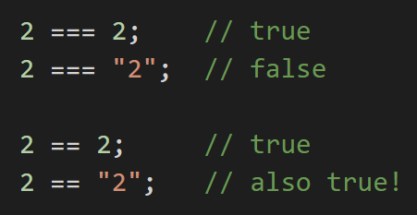
Why we don’t use ==
So, we use === to check equality in JavaScript.
But what does == do?
It performs type coercion (i.e. forces the arguments to be of the same type before comparing them)
tl;dr don’t use ==

Slide 49
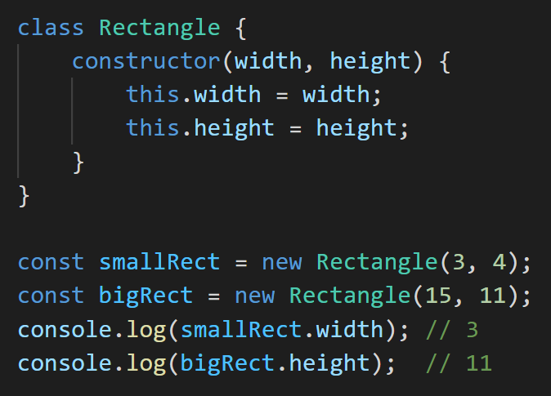
Classes
If you want multiple entities that are guaranteed to have shared behavior, use classes!
Every class has a constructor which tells it how to create a specific instance of that entity (in this case, a rectangle).
Notes:
Can have a rectangle height with a width and height
Every class has a constructor

Slide 50
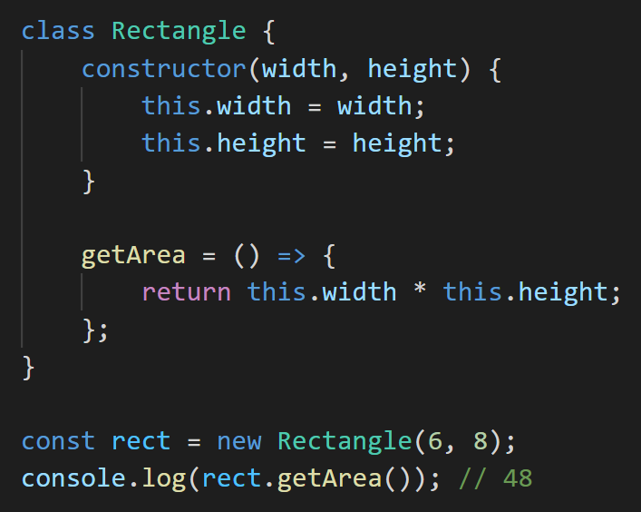
Classes
Classes have instance properties which are specific to each instance. Instance properties are accessed with the keyword this.
Classes may also contain methods (functions) which can access and manipulate instance properties. The same methods exist in every instance of the class!
Notes:
Just touching upon this because classes are a very complex thing and there is too much to cover in this short a time.

Slide 51
Summary
JavaScript is how we make things happen!
Declare variables using let, const.
boolean, number, string, null, undefined
functions, arrays, objects, classes
if, else, while, for
Up next: hands-on JavaScript workshop!

Slide 52
Questions?
Notes:
Go to catbook-react

Slide 54
W1: Javascript
Albert Xing

Slide 55

Agenda: Make Something With JS

Slide 56
Demo

Slide 57
Things We Need
Game setup
Snake
Respond to inputs
Food
Snake die

Slide 58
Let’s get started!
cd into your catbook-react folder
Run git fetch
Run git reset --hard
Run git checkout w1-starter

